Slide 1
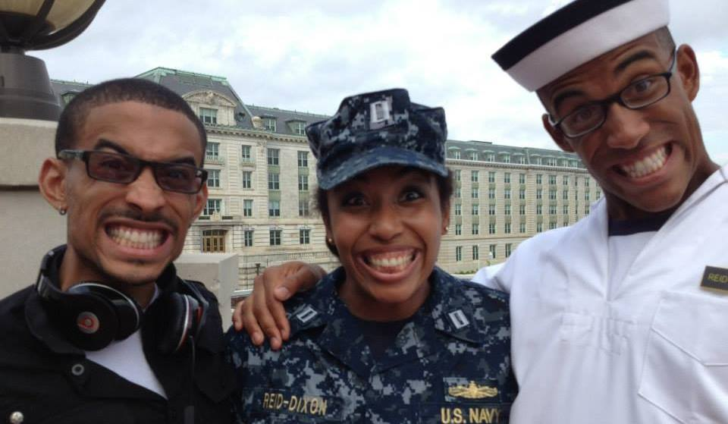
Revitalizing Midshipmen's Desire to Develop
Using USNA’s mission as a classroom tool and resource

Slide 2
Introduction
Who am i? a 2/c leadership instructor:
  Seeking a way to calibrate my students for the year
  Recognizes the reality of limited time (one semester, 50 min)
  Accepts my class won’t always be the biggest alligator next to the mind boat
  Appreciative of skepticism about Learning from a book vs learning from experience
  Understands it sometimes takes 49 minutes to turn on “thinking” in midn

Slide 3
Remind them why they’re here
The watch
Midshipmen leadership development guide
Responsibility, accountability, and discipline
know-do-be

Slide 4
“While some of us were in school learning our trade
This shipmate stood the watch”

Slide 5
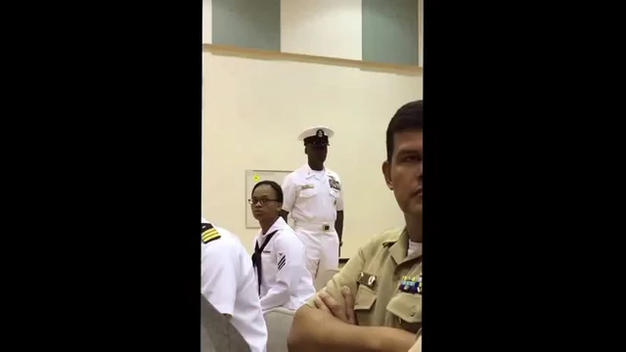

Slide 6
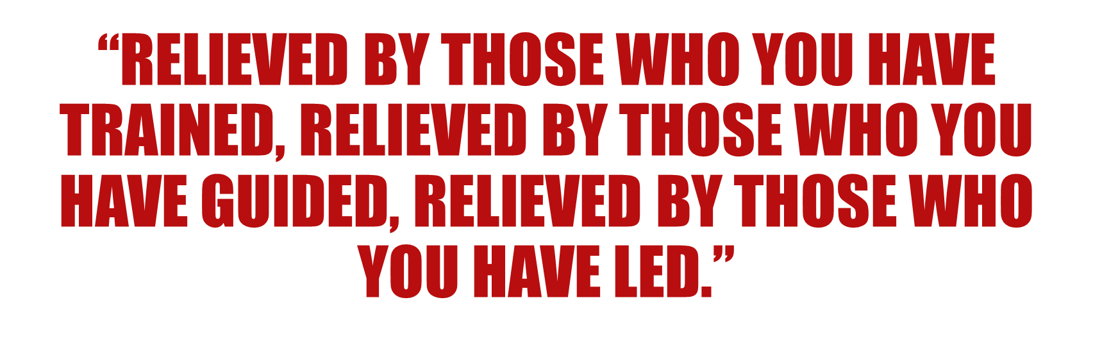

Slide 7
Transformational vs transactional teaching
Transactional: contingent rewards/punishment and management by exception
Transformational:
  Idealized influence
  Inspirational motivation
  Individualized consideration
  Intellectual stimulation

Slide 8
Tying (by force) content to experience
The watch reflection hw
“transformation to 2/c leaders” class discussion
Your story and sme
Intentional change hw
Individual Feedback sessions *voluntary*
Term paper
End of semester self assessment

Slide 9
The process of transformation
Personal identification
Social identification
Internalization
Increase in self efficacy
Notes:
Personal Identification: with the leader, want the leader’s approval)
Social Identification: link their own self worth and identity to the values and identity of the group
Internalization: the new visions and values are imbedded along with existing values
Increase in self efficacy: followers believe they have power and ability to influence difficult changes

Slide 10
Results (so far)
Midshipmen visibly more sincere about classroom topics
Classroom cohesion
Constant weaving of initial message into discussion semester wide
More relevant example material
Critical thinking via self policing

Slide 11
Your class can be transformative
Realize your opportunity as an instructor
Tangibly connect your mission in the classroom with the mission of the institution
Know who you teach and what is expected of them (mldg)
Rediscover your creativity-design thinking

Slide 12
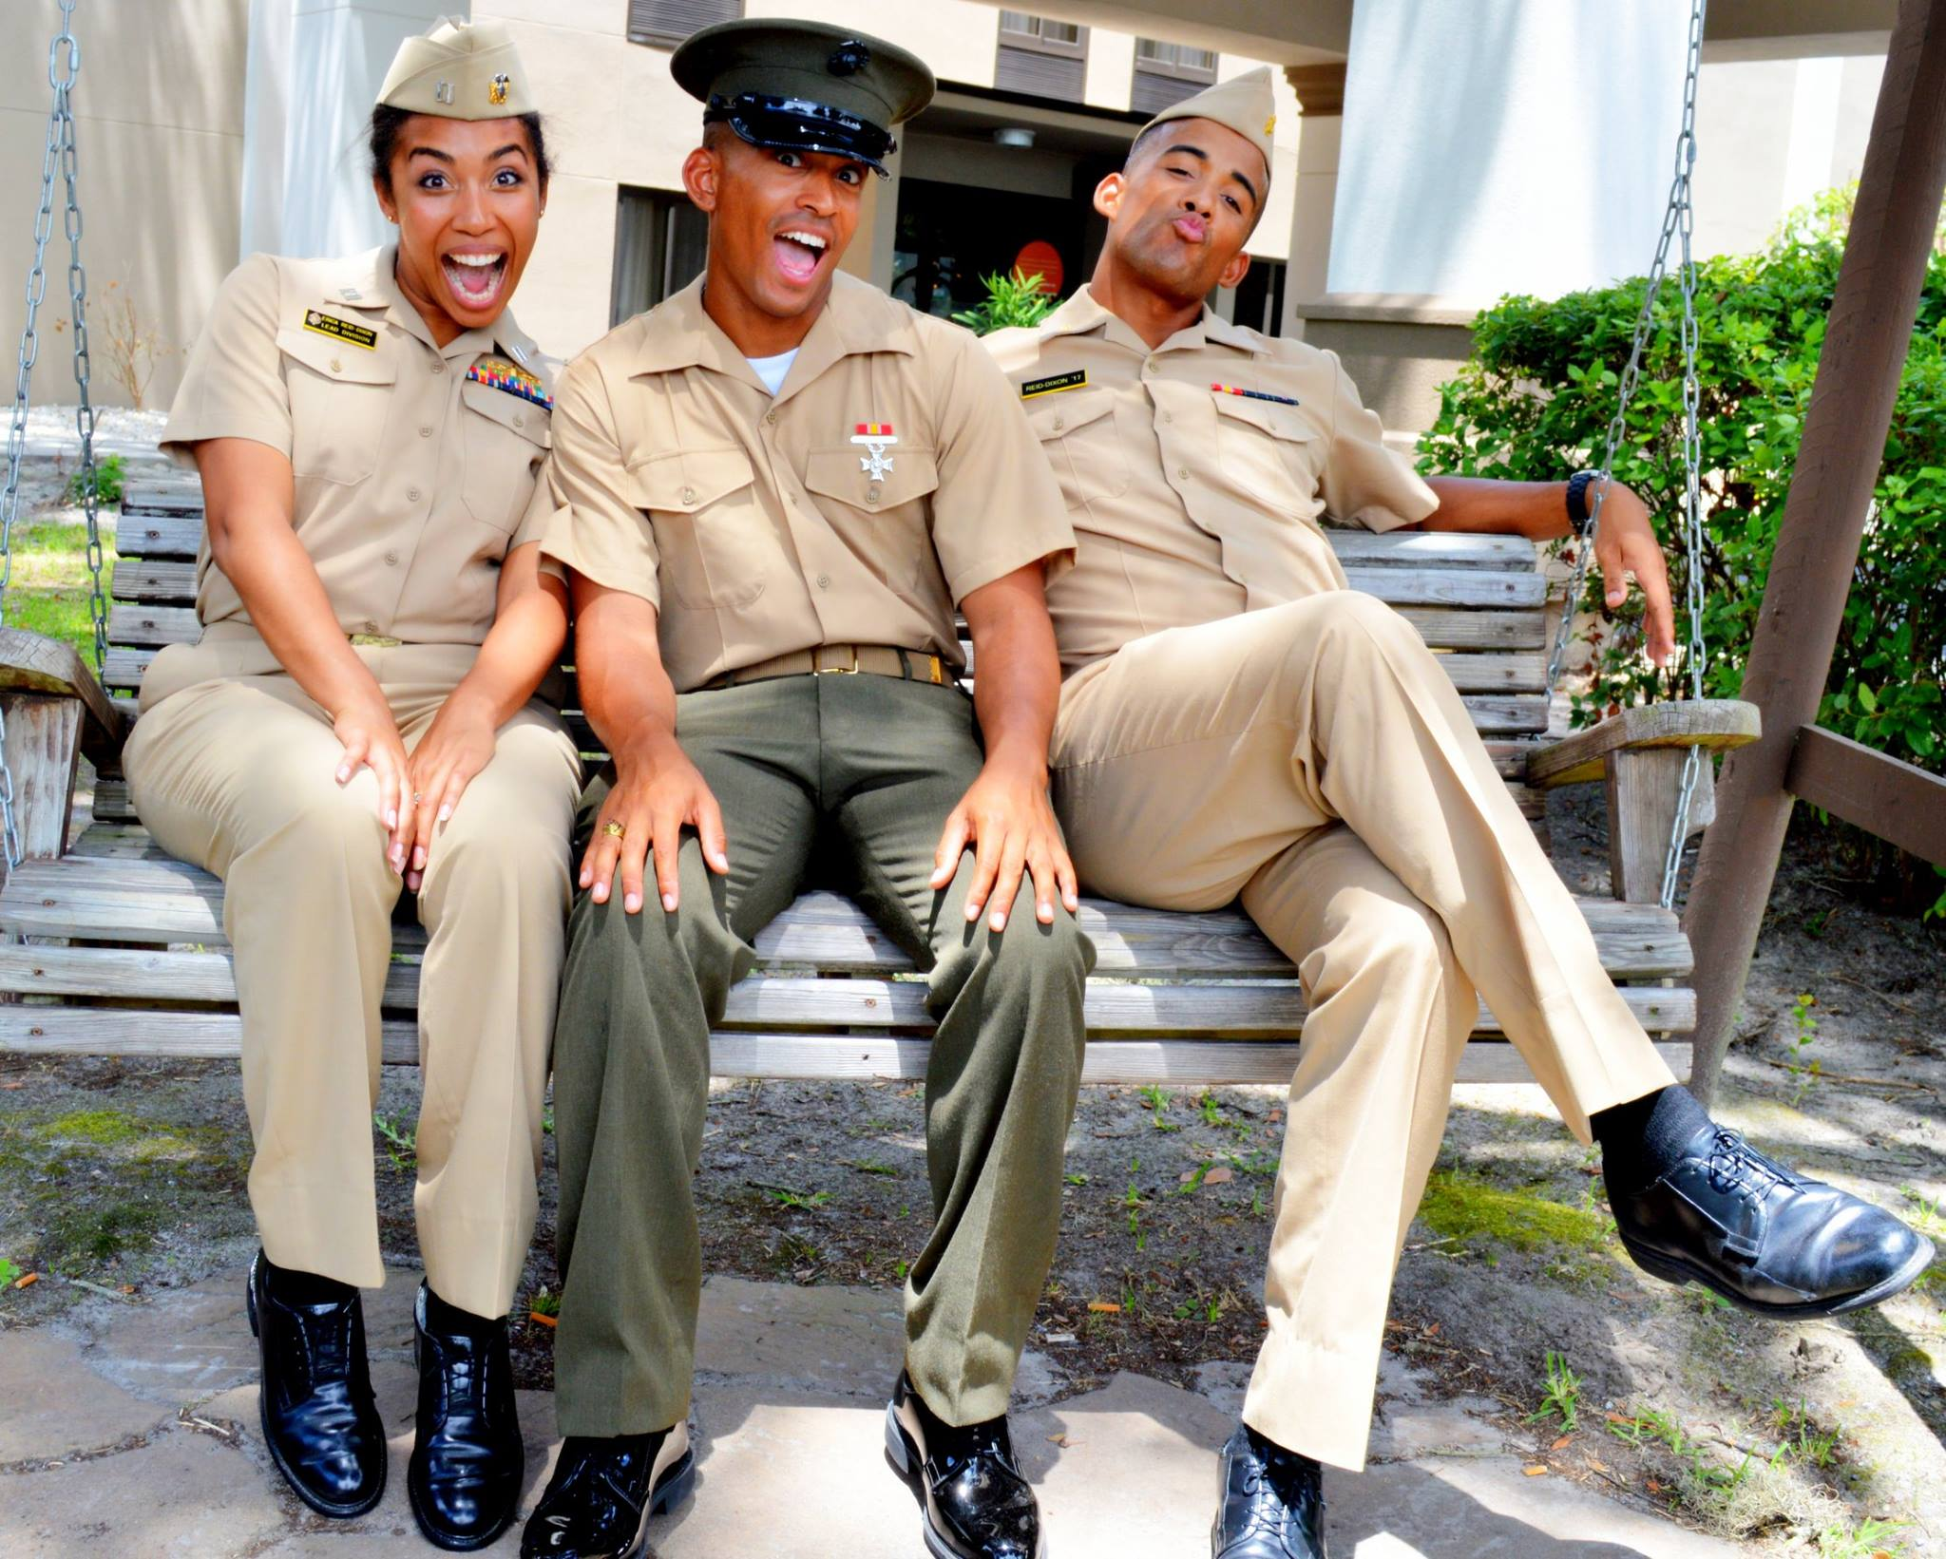
Questions?

