Slide 1
Teaching 101: Get the Gouge
Karyn Z. Sproles, PhD
USNA’s Center for Teaching & Learning
LCDR Lori Goodenough
Mechanical Engineering Department

Slide 2

Heard around the lunch table
It was really a question of pedagogy . . .
What’s a pedagogy?

Slide 3
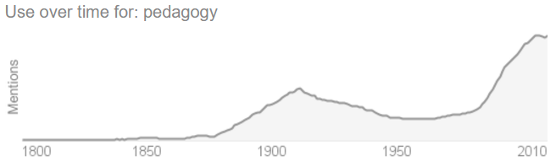
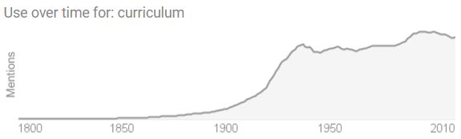
Pedagogy and Curriculum
Graphs developed using Google Books Ngram Viewer (https://books.google.com/ngrams)
Notes:
“By 1918, every state required students to complete elementary school. . . . Approximately 200,000 students attended high schools in 1890 and almost 2,000,000 by 1920, an increase from 7% of the 14 to 17 year old population to over 30%.” (http://www.huffingtonpost.com/alan-singer/welcome-back-a-brief-hist_b_8098916.html)

Slide 4

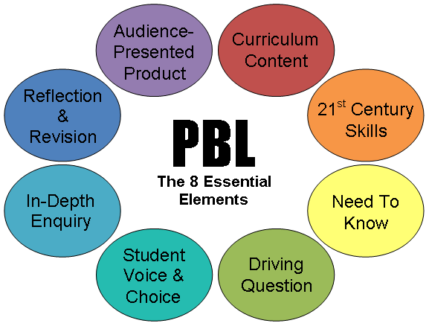
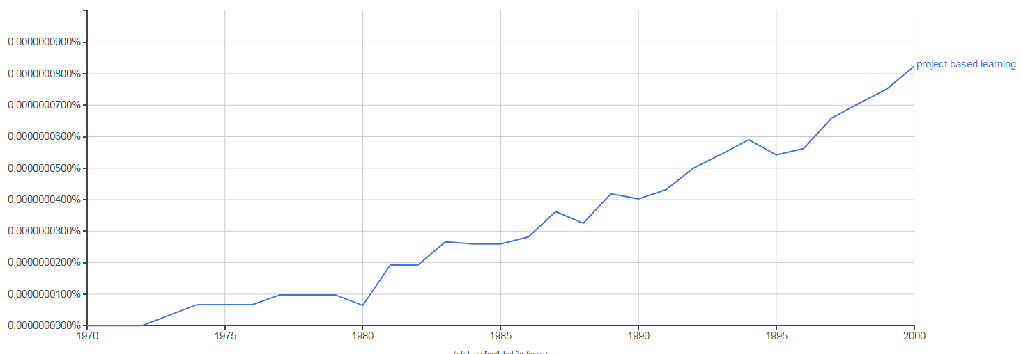
Problem-Based and Project-Based Learning
http://imcreativeteaching.blogspot.com/2014/05/the-8-essential-elements-of-project.html
Graph developed using Google Books Ngram Viewer (https://books.google.com/ngrams)

Slide 5
A Brief History of Educational Theory: Case for Active Learning
I. An interactive Quiz

Slide 6
What is ACTIVE LEARNING?
Learning by:
Doing
Discussing
Writing
Thinking
Engaging

Slide 7
True or False?
Active Learning is a recent trend that is not yet supported by theoretical or applied research.

Slide 8

False
Active learning has its origins in the theoretical work of psychologist and learning theorist Jean Piaget
Brain-based learning research affirms (but rarely acknowledges) Piaget’s findings
Applied research testifies to the greater retention resulting from Active Learning
NSSE data demonstrates a correlation between student engagement and student success

Slide 9
True or False?
The opposite of Active Learning is rote learning.

Slide 10
True
Active Learning encourages students to engage with material—not just memorize it.

Slide 11
True or False?
Active Learning attempts to increase learning for more students by appealing to a variety of learning styles.

Slide 12
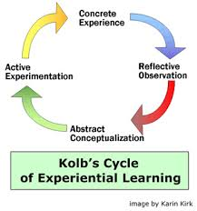
True
Concrete Experience: Labs
Reflective Observation: Journals
Abstract Conceptualization: Model Building
Active Experimentation: Case Studies

Slide 13
True or False
Active learning might be fun, but lectures cover more material.

Slide 14
True
But research shows that students retain about 50% of the lecture (when tested immediately afterward)

Slide 15
Brain Based Learning
Our Goal:
How to get what we teach students into their long-term memory

Slide 16
How do you learn?
In groups of 5 or 6
Think about the classes you have taken
    What helped you learn?
    What hindered your learning?

Slide 17
Does prior knowledge help you learn new material?
When did it help you learn?
When did it hinder your leaning?

Slide 18
LEARNING = MENTAL MODELS
Experience = the earth is flat
Education = the earth is round

Slide 19
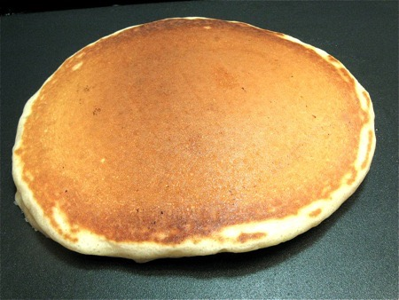
Prior Knowledge of Round

Slide 20
For Learning to work
Activate prior knowledge = round
Recognize the flaws in prior knowledge = not flat
Apply new knowledge in order to adjust mental model = ball
Retrieve new knowledge in order to move it into long-term memory = study

Slide 21
What is the problem with short term (or working) memory?
Think
Pair
Share

Slide 22
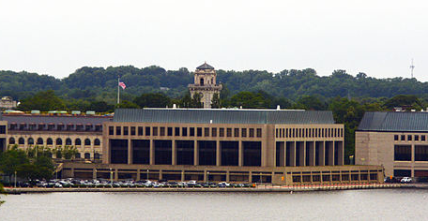
Long Term Memory Increases with Need

Slide 23

Short Term Memory is Finite

Slide 24


How can we get short term memories into long term memory?

Slide 25

Predicting: Make it Interesting
What formula might we use to solve this equation?
What results do you think we will get?
How do you think this will turn out?

Slide 26

Spaced retrieval

Slide 27

Self-Explaining

Slide 28
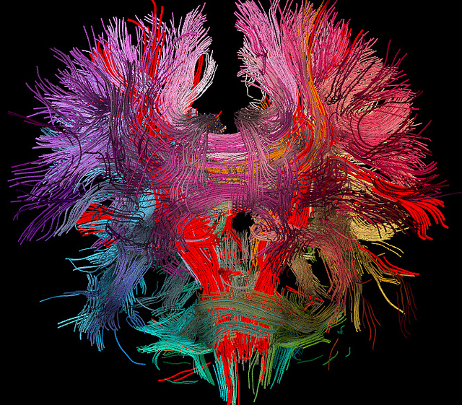
Connecting

Slide 29

Reflecting
Journals
Reflections
1-minute papers:
  Most important point
  Muddiest point

Slide 30
True or False?
Active learning caters to Millennial learning preferences.

Slide 31

True
Millennial Learning
Relevant
Rationale
Relaxed
Rapport
Research-based teaching methods; i.e.,
Active Learning
Price, “Why Don’t My Students Think I’m Groovy,” p. 5.
Dr. Christy Price, Dalton State University

Slide 32
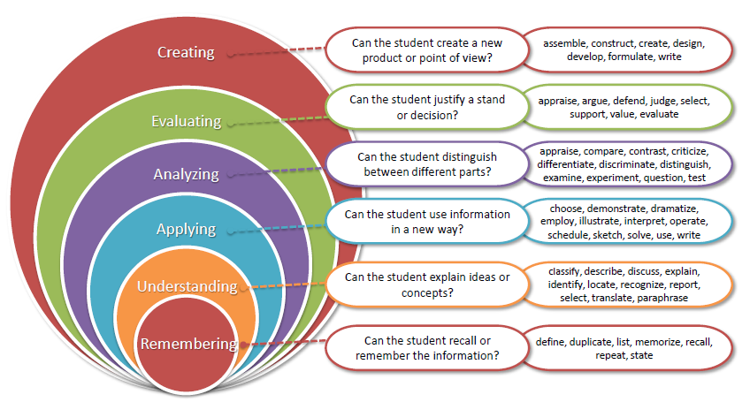
Bloom’s Revised Taxonomy

Slide 33
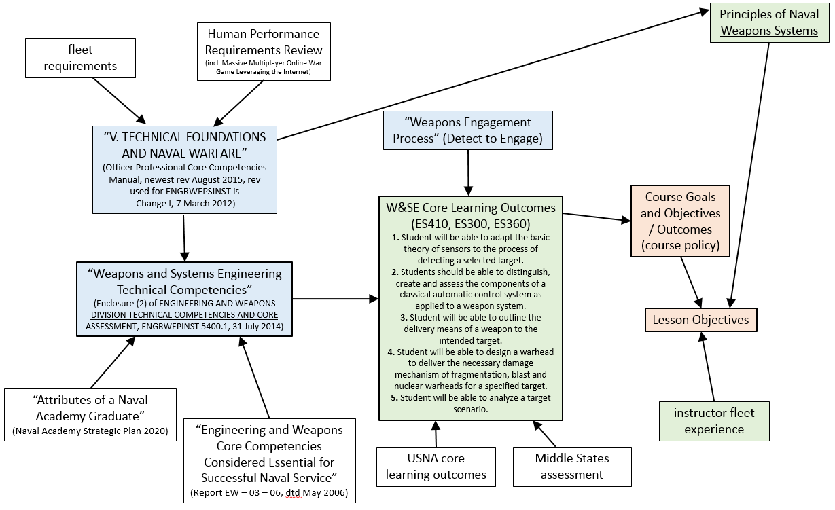

Slide 34
A Few Rules of Thumb
3
Students should be given ____ times the amount of time it takes the instructor to complete an exam.
1 credit hour of meeting time typically corresponds to _____ hours of homework and reading per week.
Method of course material delivery should vary every ____ minutes.
2-3
10

Slide 35
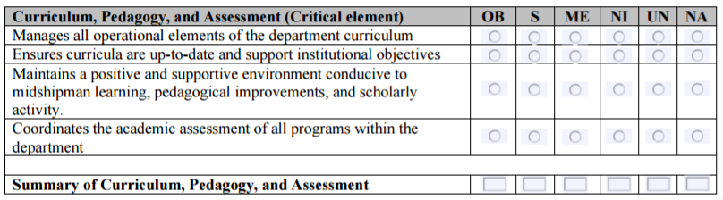
USNA Values Teaching
Selection from the Civilian Department Chair performance report

Slide 36
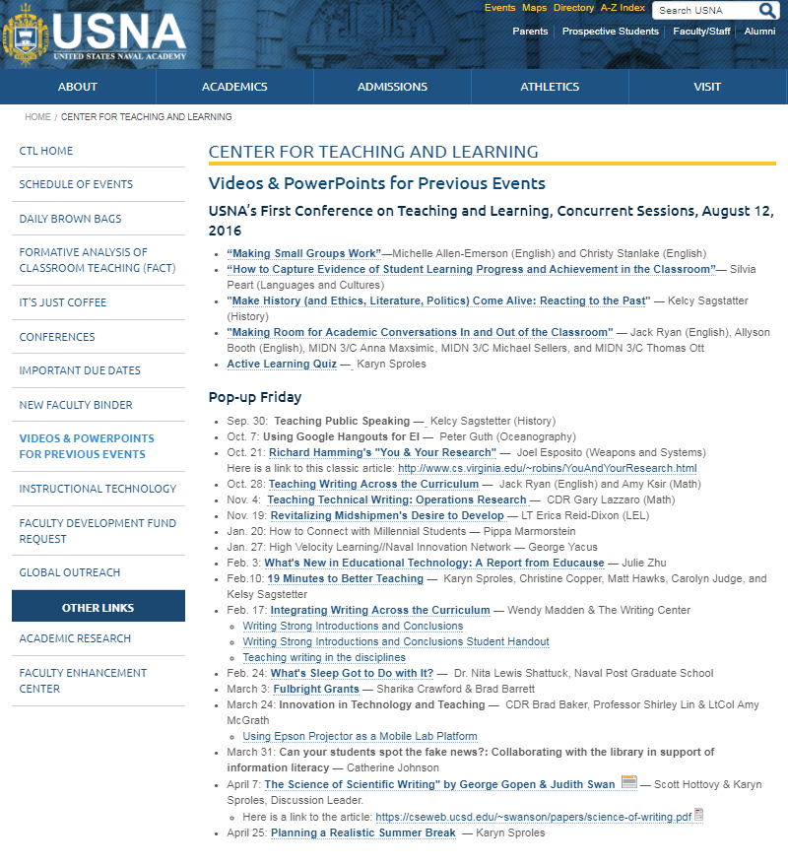

https://www.usna.edu/CTL/index.php

Slide 37
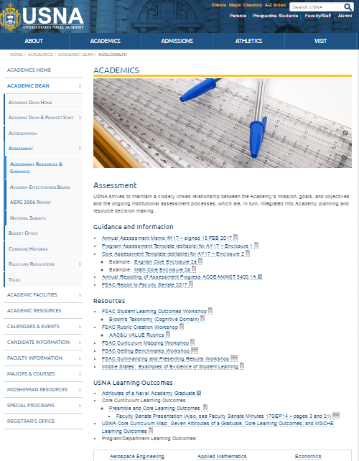
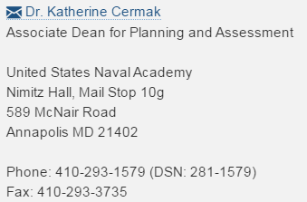
https://www.usna.edu/Academics/Academic-Dean/Assessment/index.php

Slide 38
What Active Learning exercises did we do during this workshop?

