Slide 1


Slide 2
Center for Experiential Leadership Development (ELD)
LEAD Division, Luce Hall
Col Maria “MJ” Pallotta, USMCR
pallotta@usna.edu

Slide 3
Center for ELD
The Center functions as the bridge between leadership curricular programs and hands-on experiential leadership development programs at USNA.
ELD is learning by doing.
  Based on the 20th century education theories of John Dewey, Benjamin Bloom, and David Kolb.
  Three ELD domains, tied together through reflection and the Socratic method:
    Cognitive - acquiring information.
    Affective - emotional involvement and commitment.
    Psychomotor - physical engagement.

Slide 4
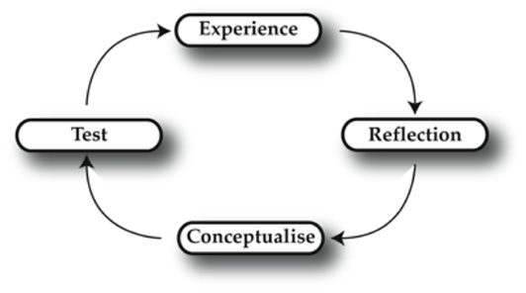
Kolb Cycle of Experiential Learning

Slide 5
ELD History
The Experiential Leadership Development Program was established as a proof-of concept in 2011. The Center for ELD was formally established in 2017 to meet the growing demand for ELD programs.
  Success of ‘77 Gettysburg Leadership Encounter (GLE), National Outdoor Leadership School (NOLS), Offshore Sailing Training Squadron (OSTS), Plebe Detail Leadership Training (LDEP), Naval Academy Women’s Network (NAWN), Outward Bound, etc.
  Ad hoc, time-consuming, and stove-piped processes led to a need for centralized execution.
    Different people led each program.
    Leadership instructors are returned to the classroom.
● Generous recent philanthropic donations enabled the creation of a Center for ELD.
Director and Ed Tech.
More resources for midshipmen ELD programs throughout the year.

Slide 6
Center for ELD
Class of ‘77 Gettysburg Leadership Encounter (GLE).
  Began as a Patriot League initiative with NAAA in 2012.
  Widespread success; outstanding support from both NAAA and the Class of ‘77.
Outward Bound - Baltimore.
  Third year of spring break hikes on the Appalachian Trail.
    18 mids & 18 veterans in 2018 & 19.
    Block I training on land and Potomac River.
    Future: Day trips to Baltimore for ropes courses.
Offshore Sailing Training Squadron (OSTS).
  Well-established program. Experiential leadership at its best.
  ~260 midshipmen each summer.

Slide 7
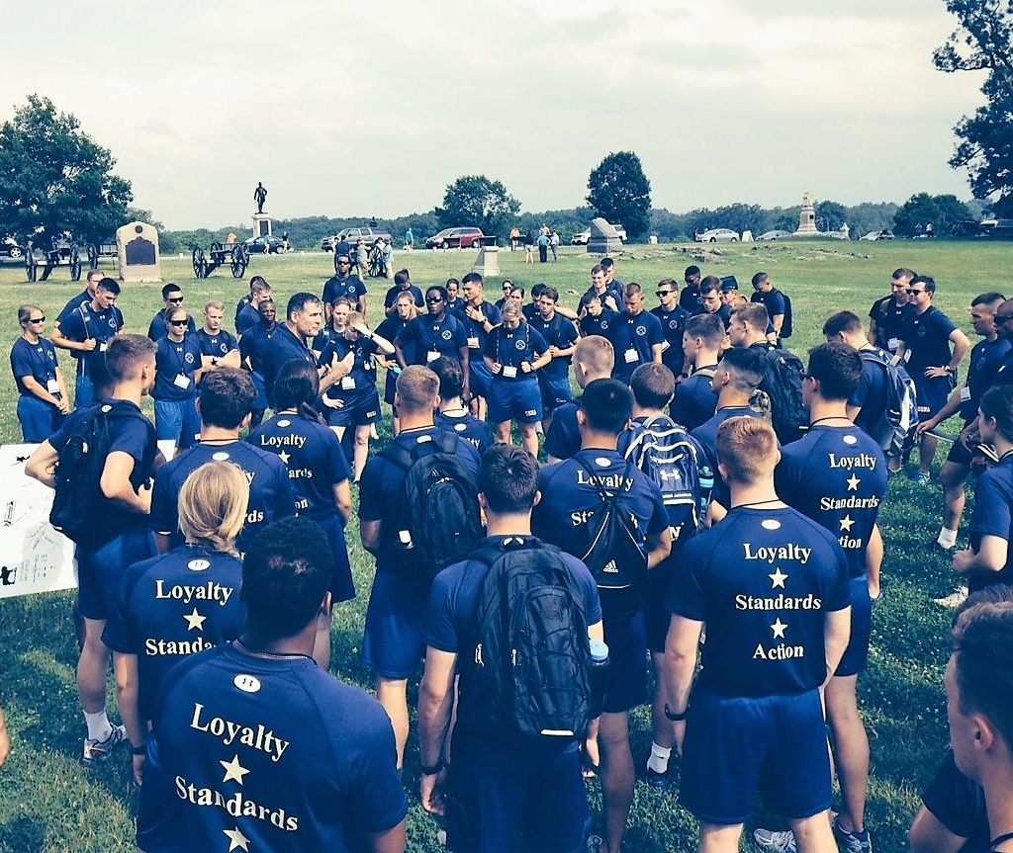
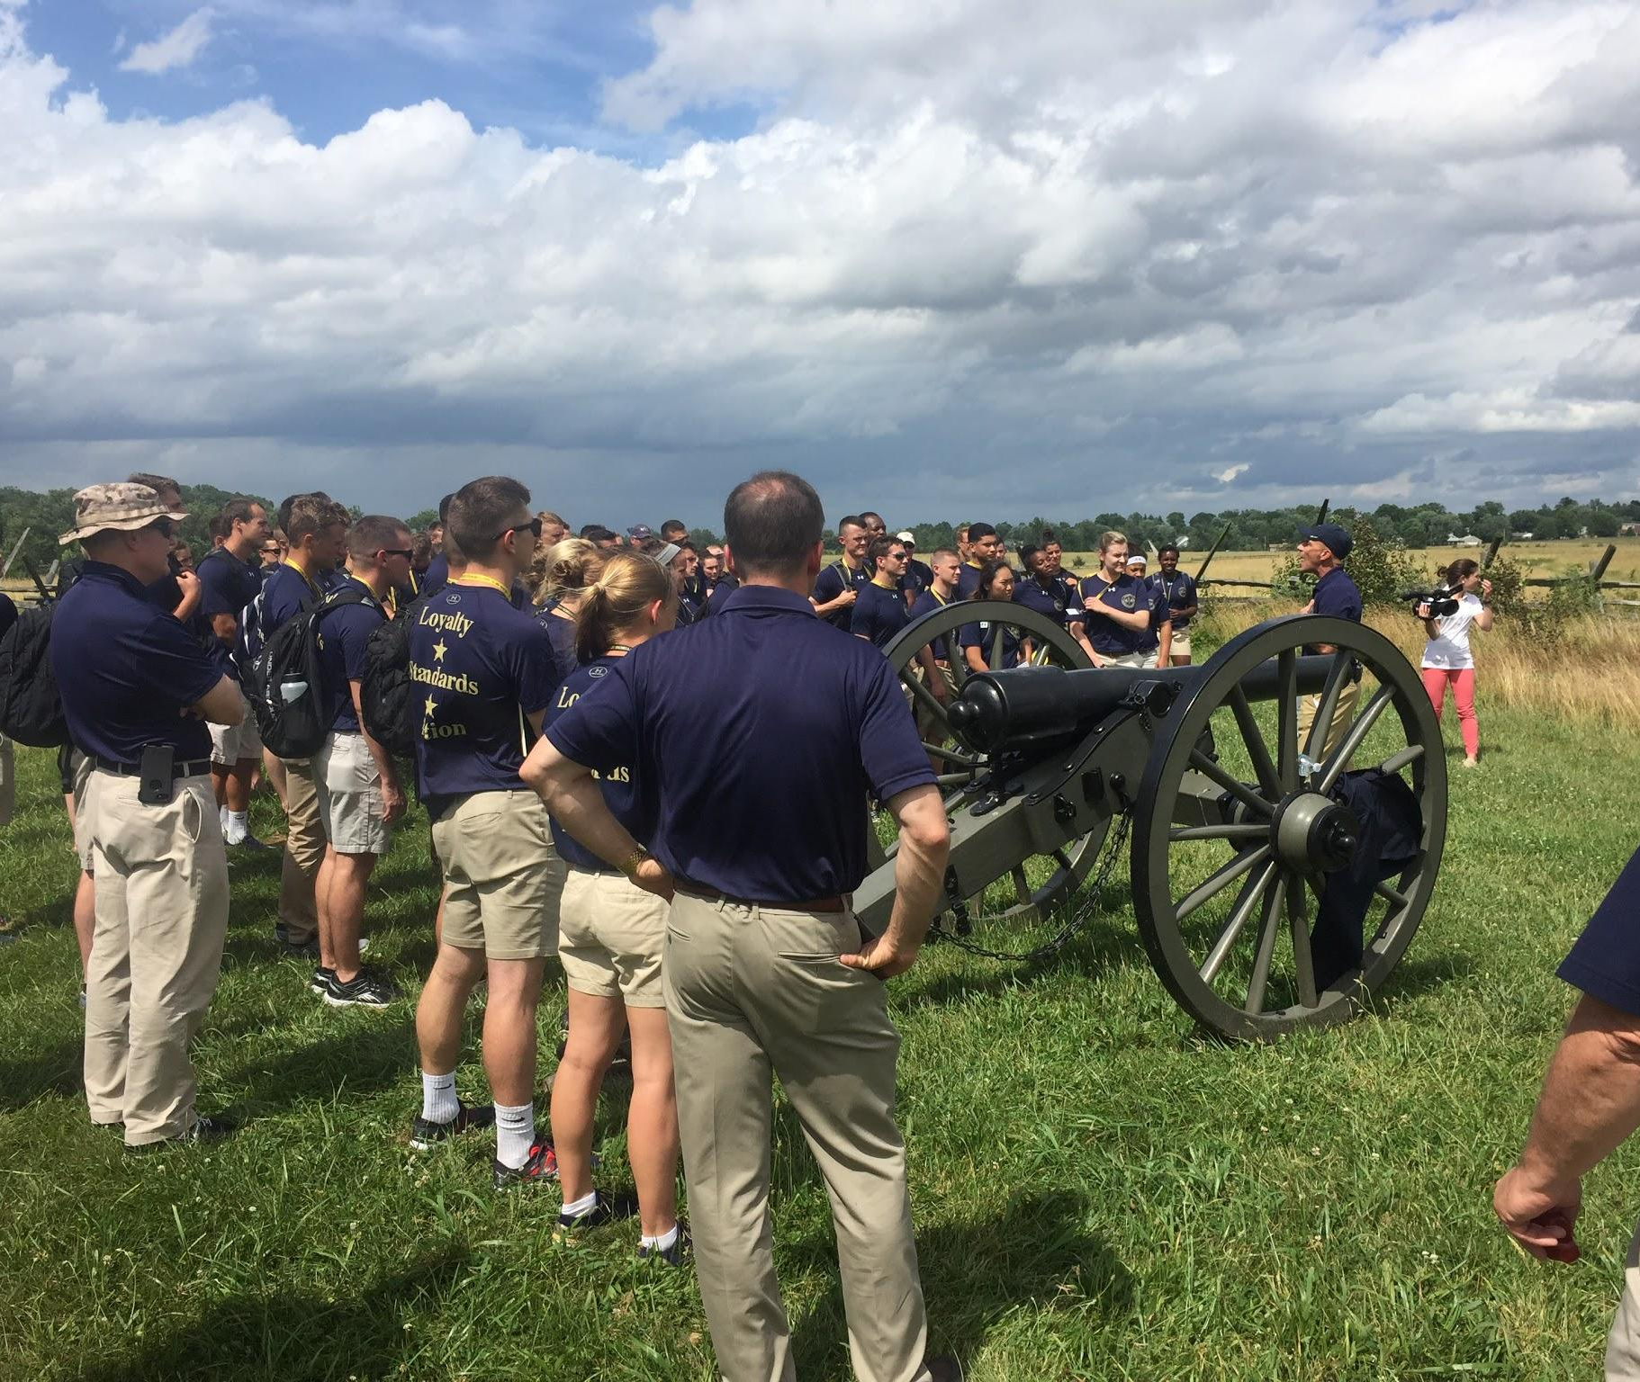
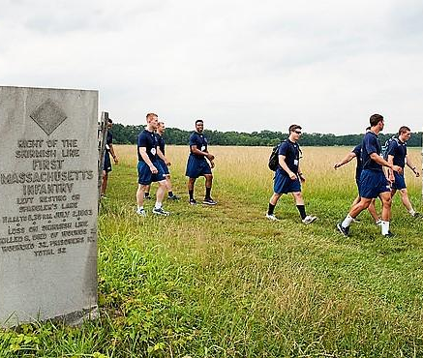
Gettysburg Leadership Encounter

Slide 8
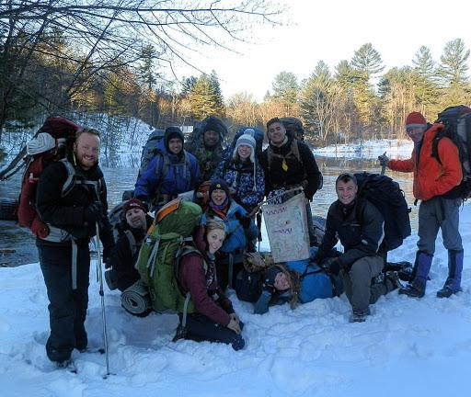
Outward Bound
Spring Break Hike

Slide 9
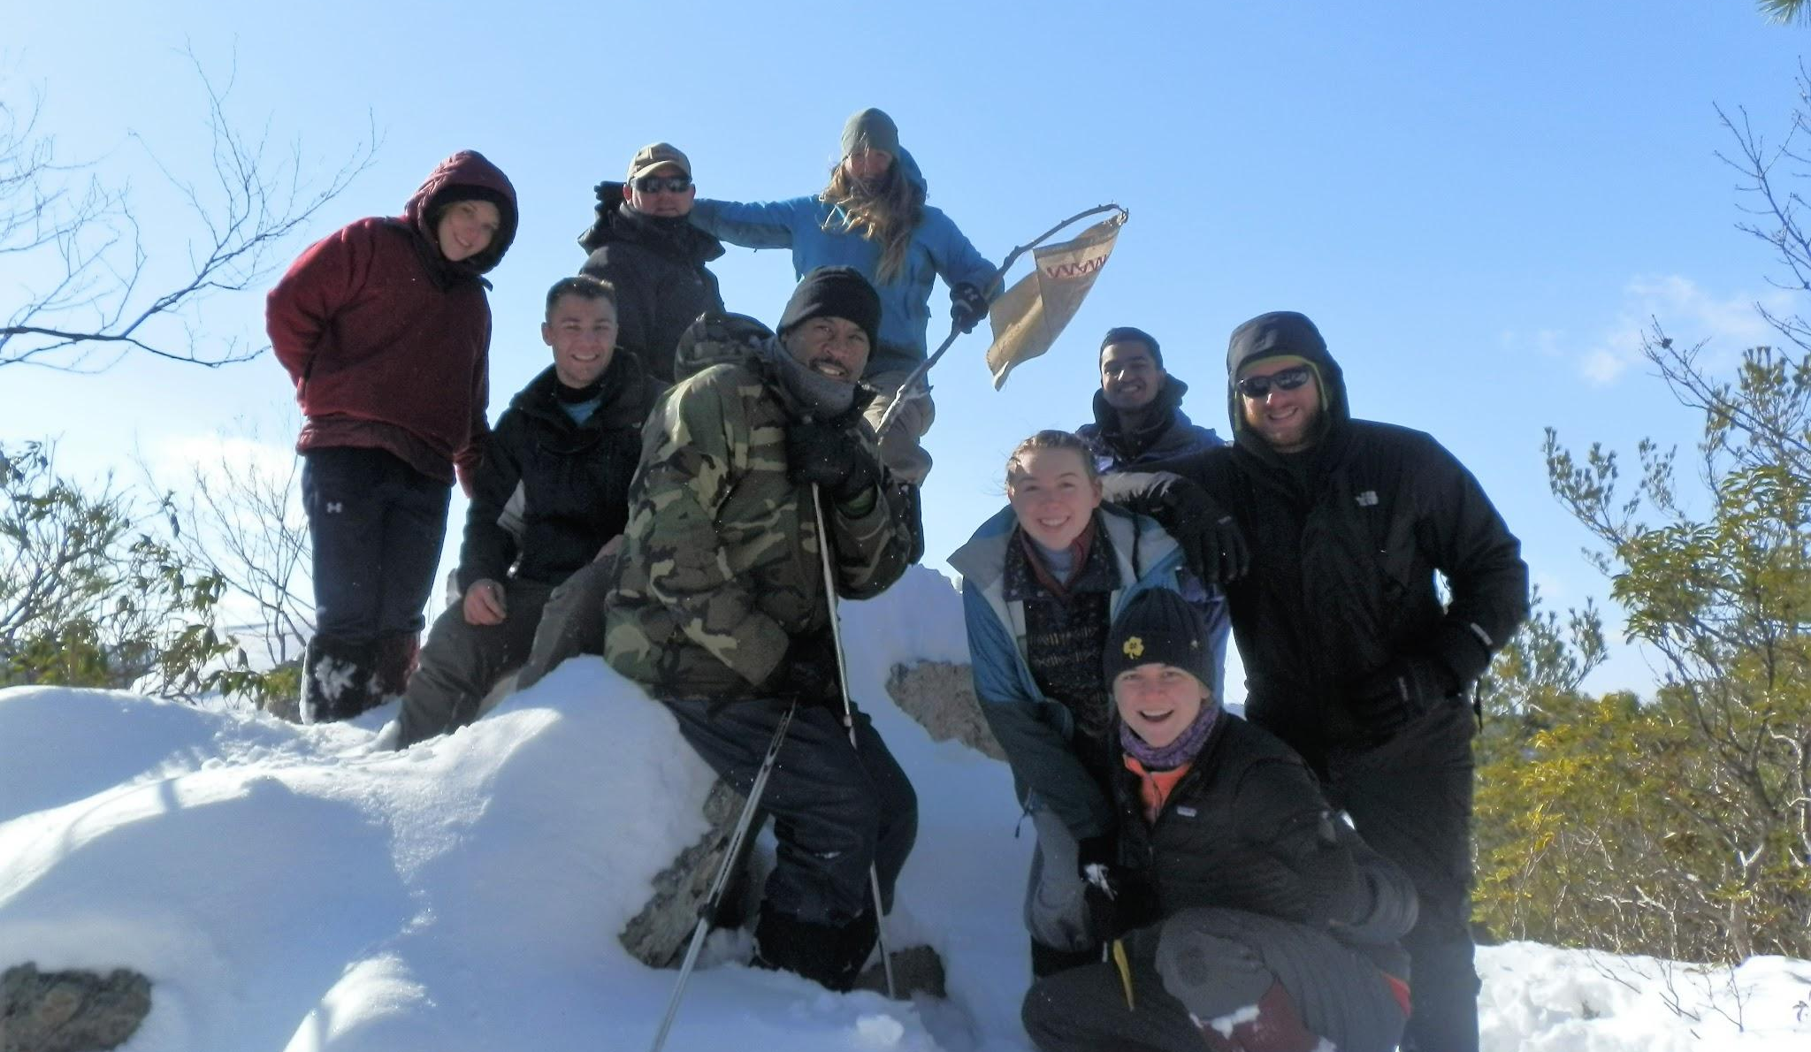
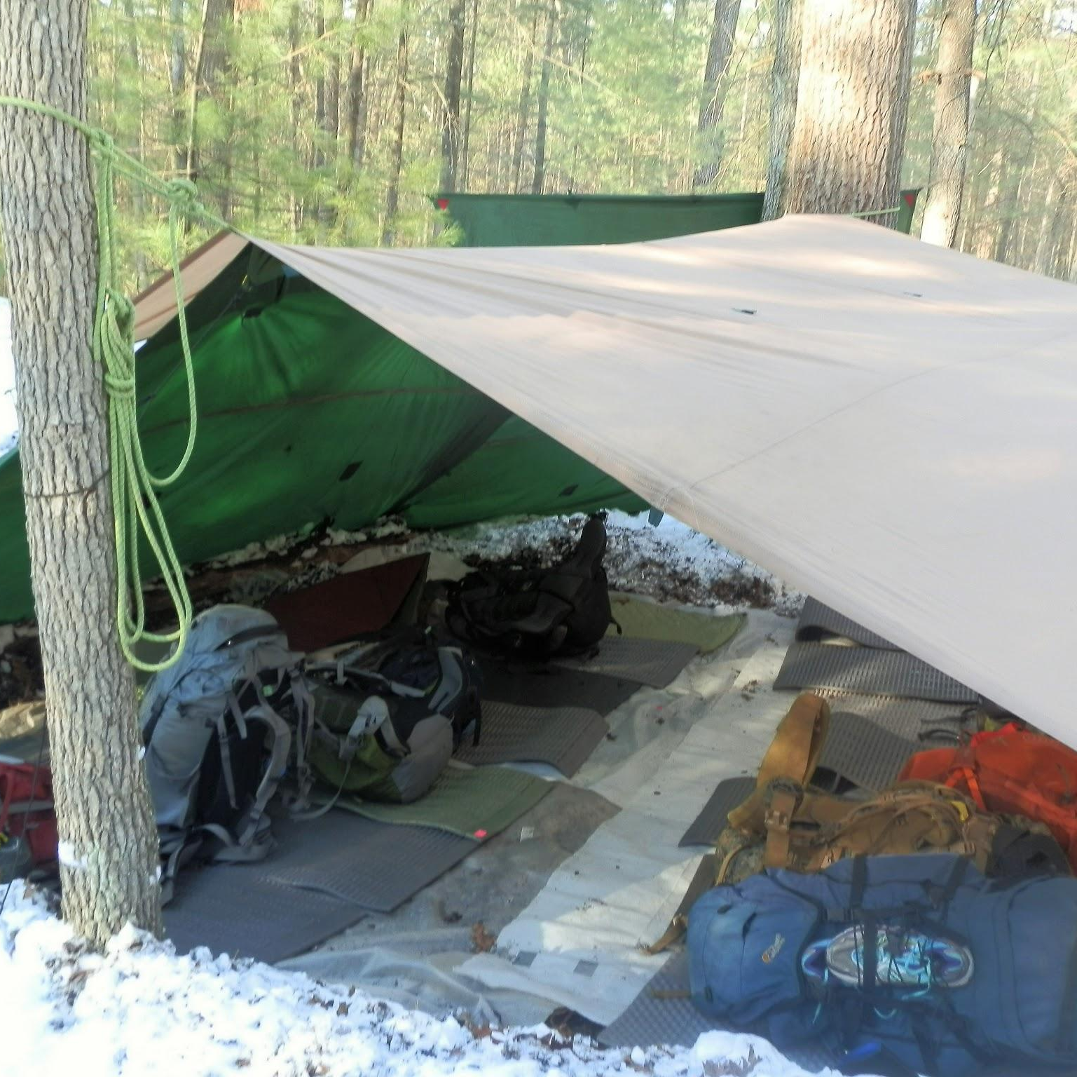

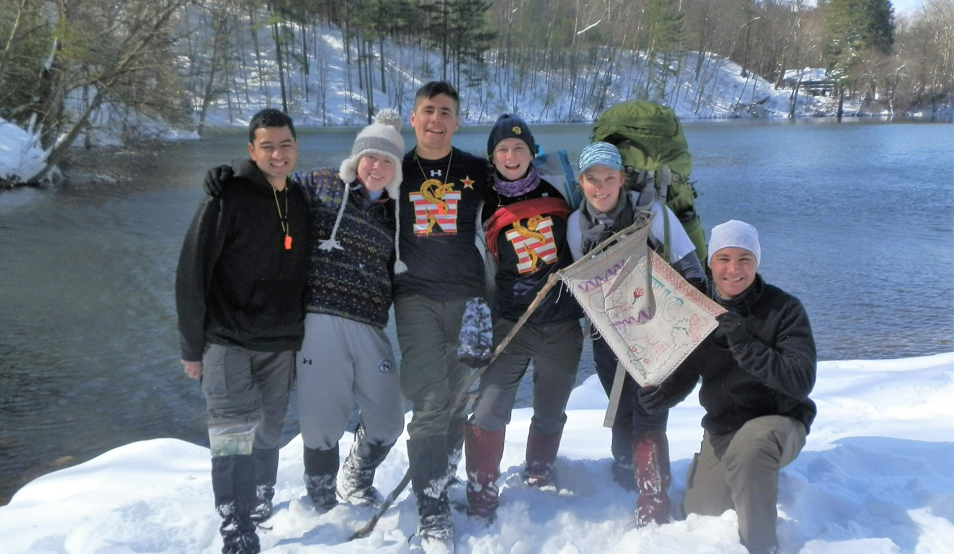
Outward Bound

Slide 10
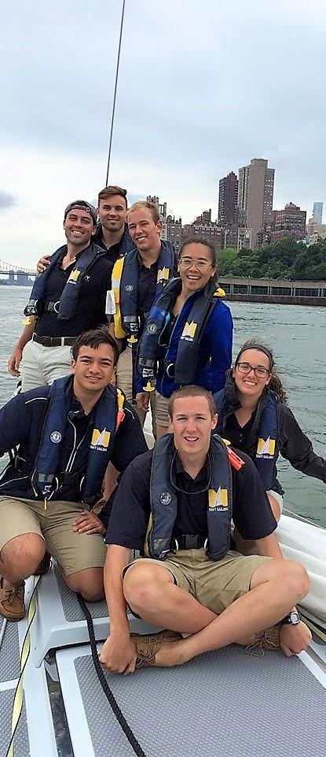
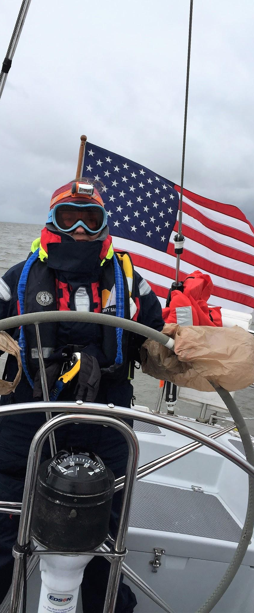
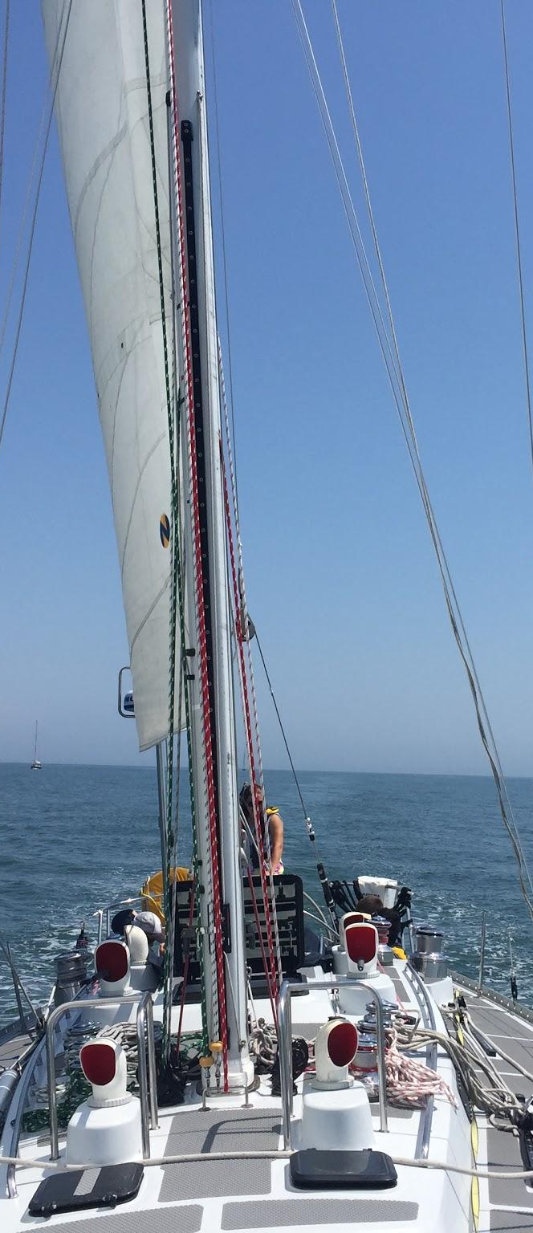
Offshore Sailing Training Squadron (OSTS)

Slide 11
Center for ELD
Naval Academy Women’s Network (NAWN).
  Established in 2013. Mentoring, networking, Lean-in Circles for staff and mids, women AND men.
  Summer training blocks in concert with NOLS and IPO.
National Outdoor Leadership School (NOLS).
  Relationship began in 2004 with SEAL selectees.
  175-240 mids each summer.
  WY backpacking, AK mountaineering & backpacking, AK sea kayaking, Canadian Yukon Canoeing.
  Highly popular and well-regarded. Superlative feedback from the mids on its leadership value.
St. Benedict’s and Sisters Academy, NJ.
Fund for battlefield tours and military museum visits.
  Combined effort with International Programs Office (IPO).
  Vietnam summer 2019.

Slide 12
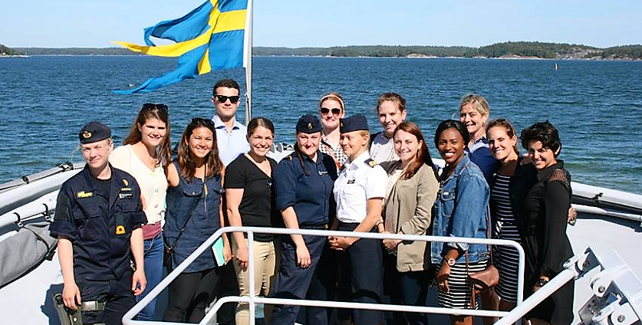
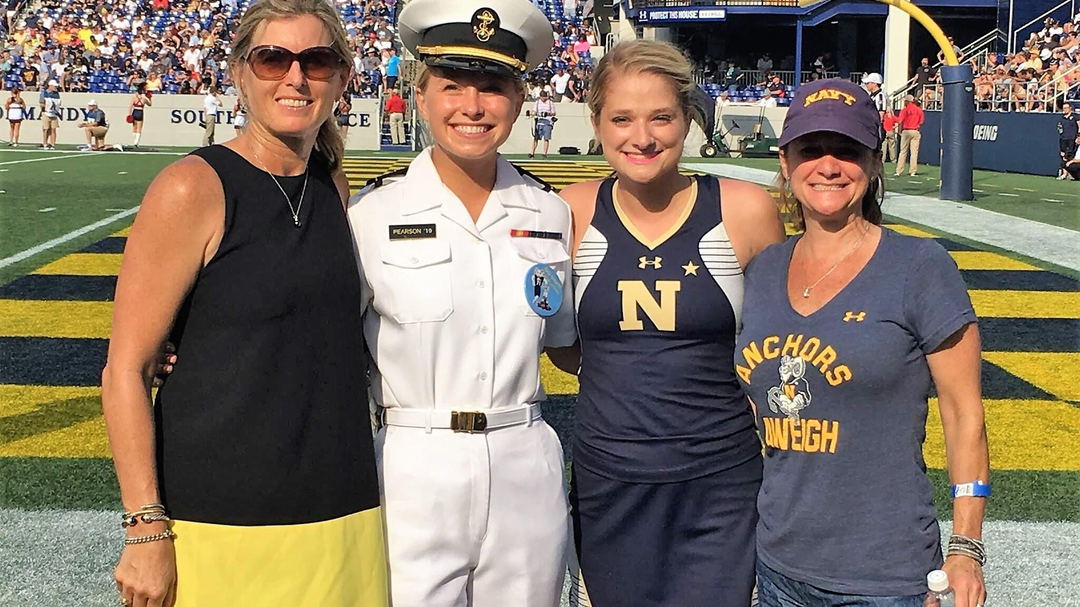
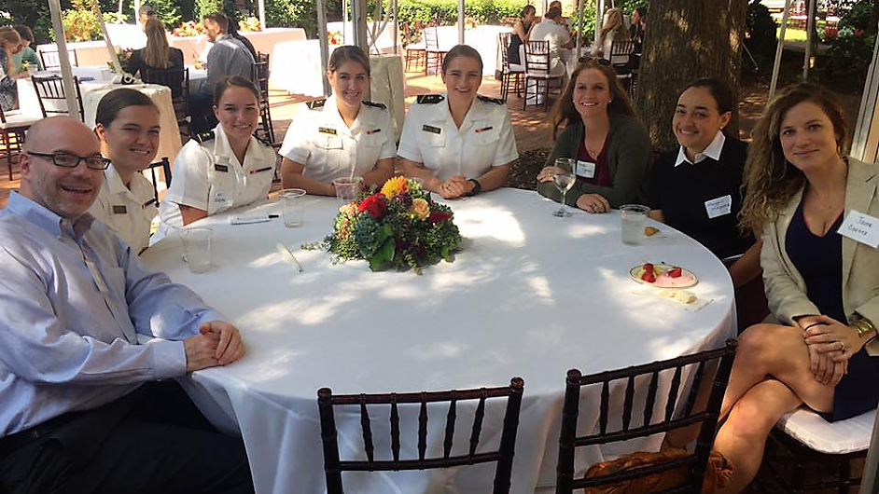
Naval Academy Women’s Network (NAWN)

Slide 13
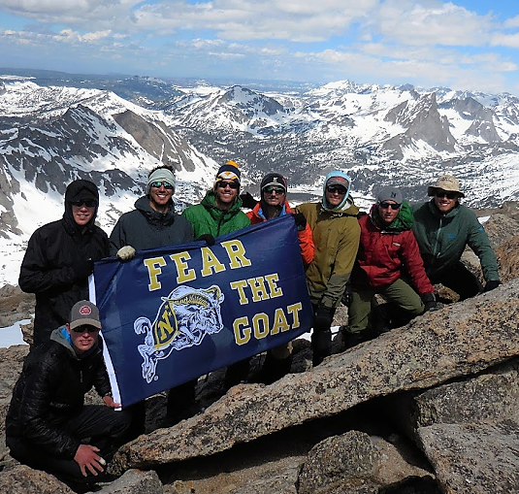


NOLS Wyoming Backpacking

Slide 14

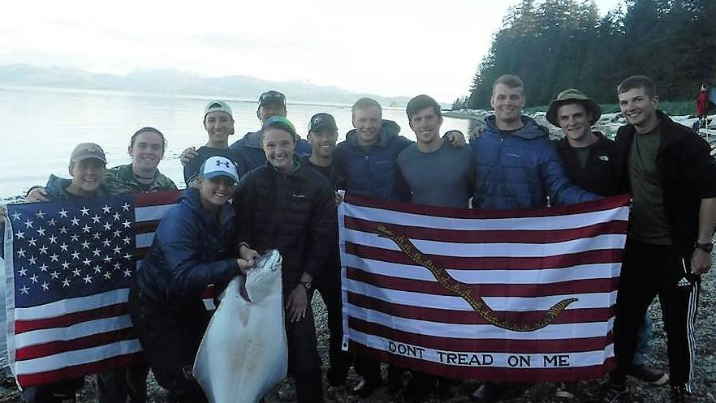
NOLS Alaska Sea Kayaking

Slide 15
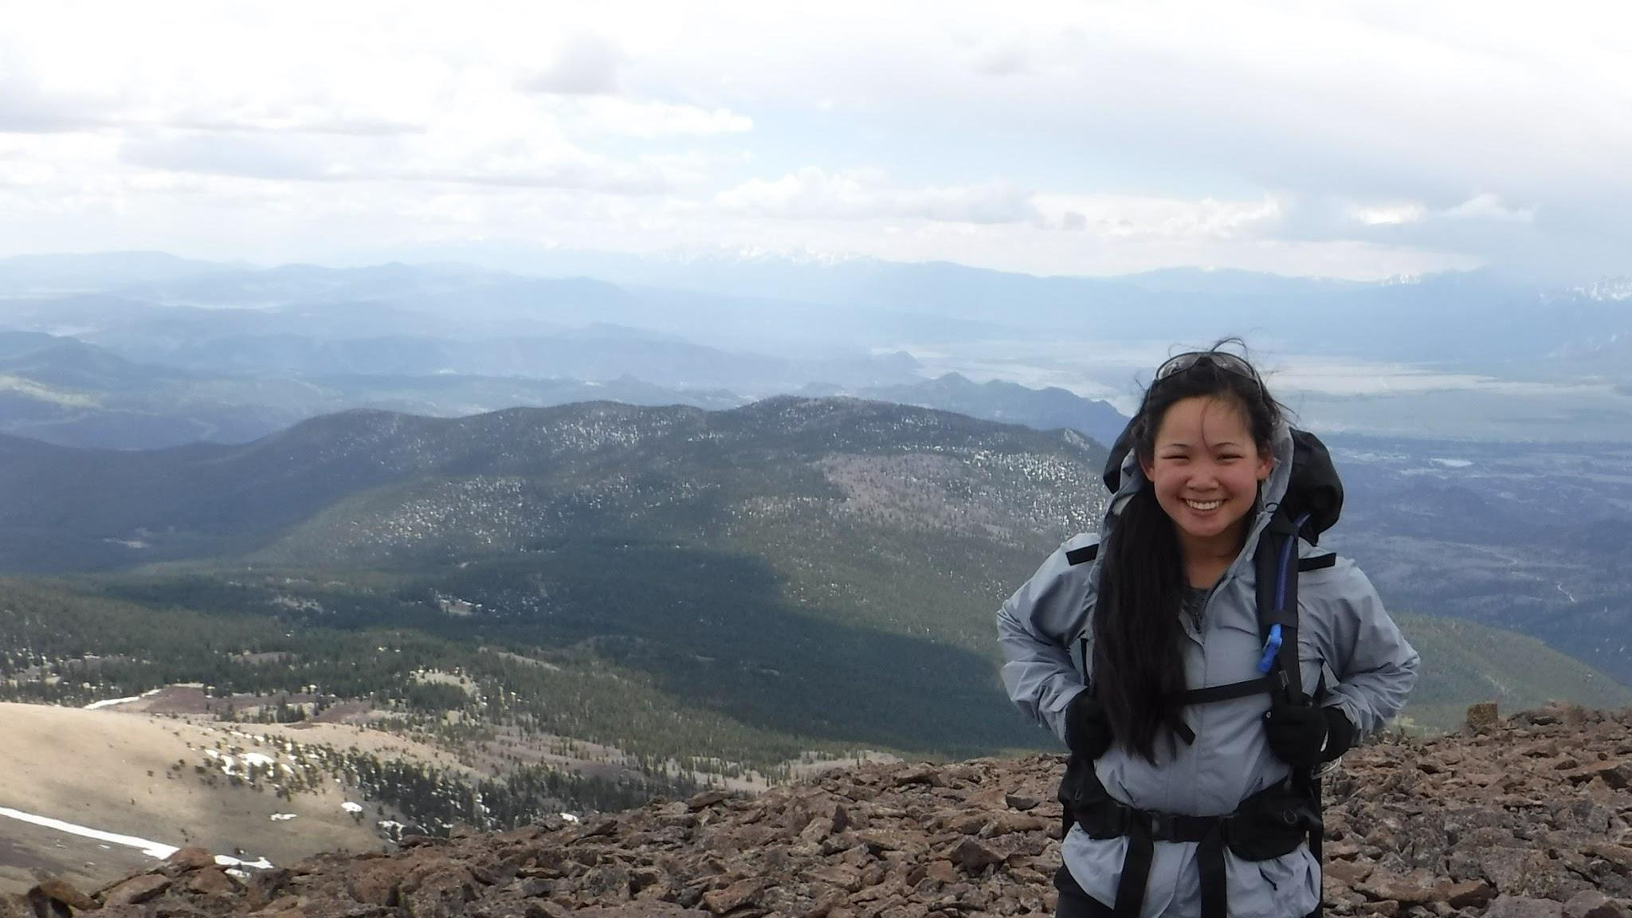



NOLS Wyoming Backpacking

Slide 16
NOLS Denali

Slide 17
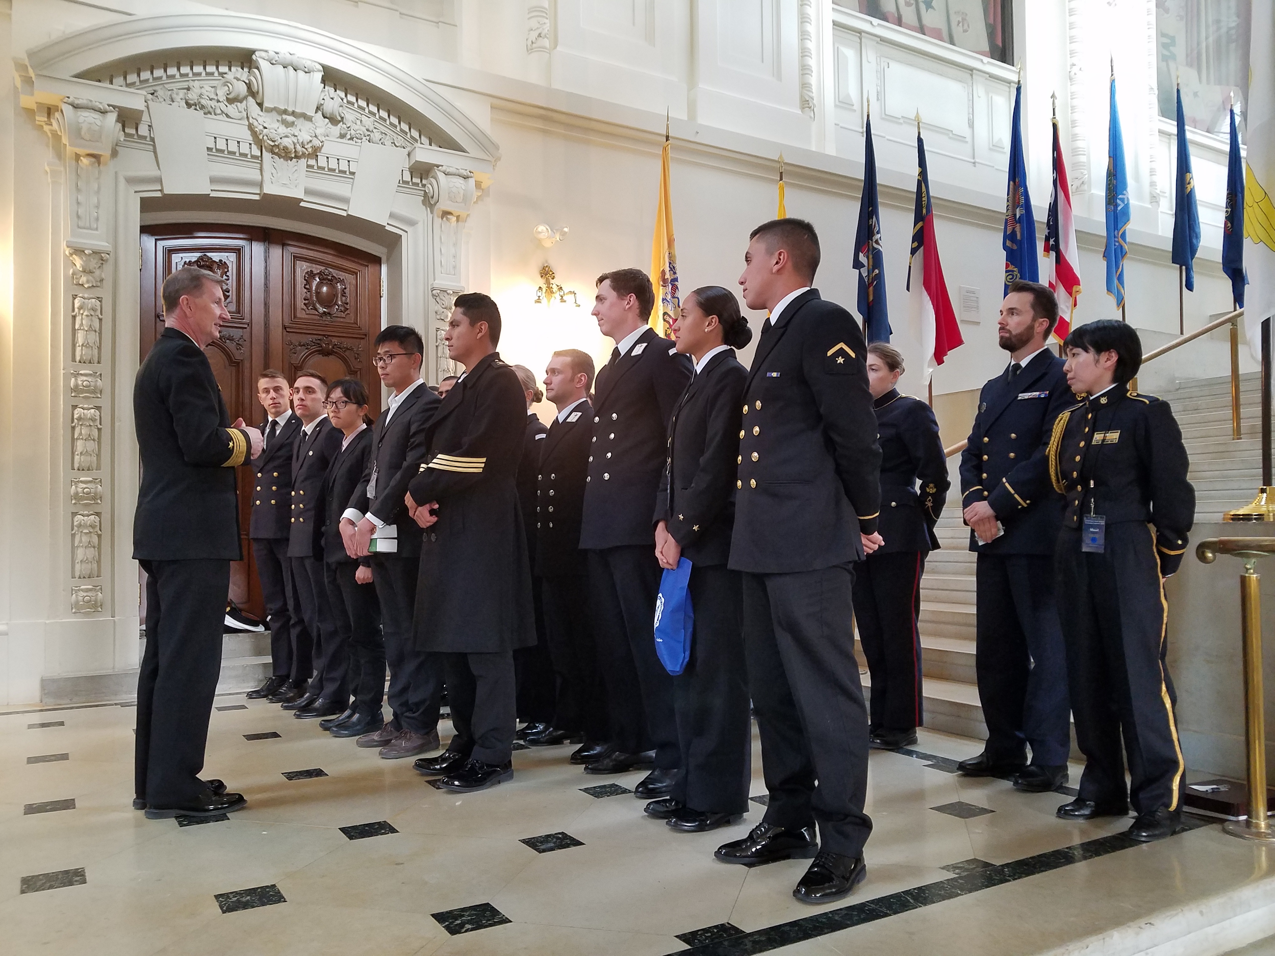
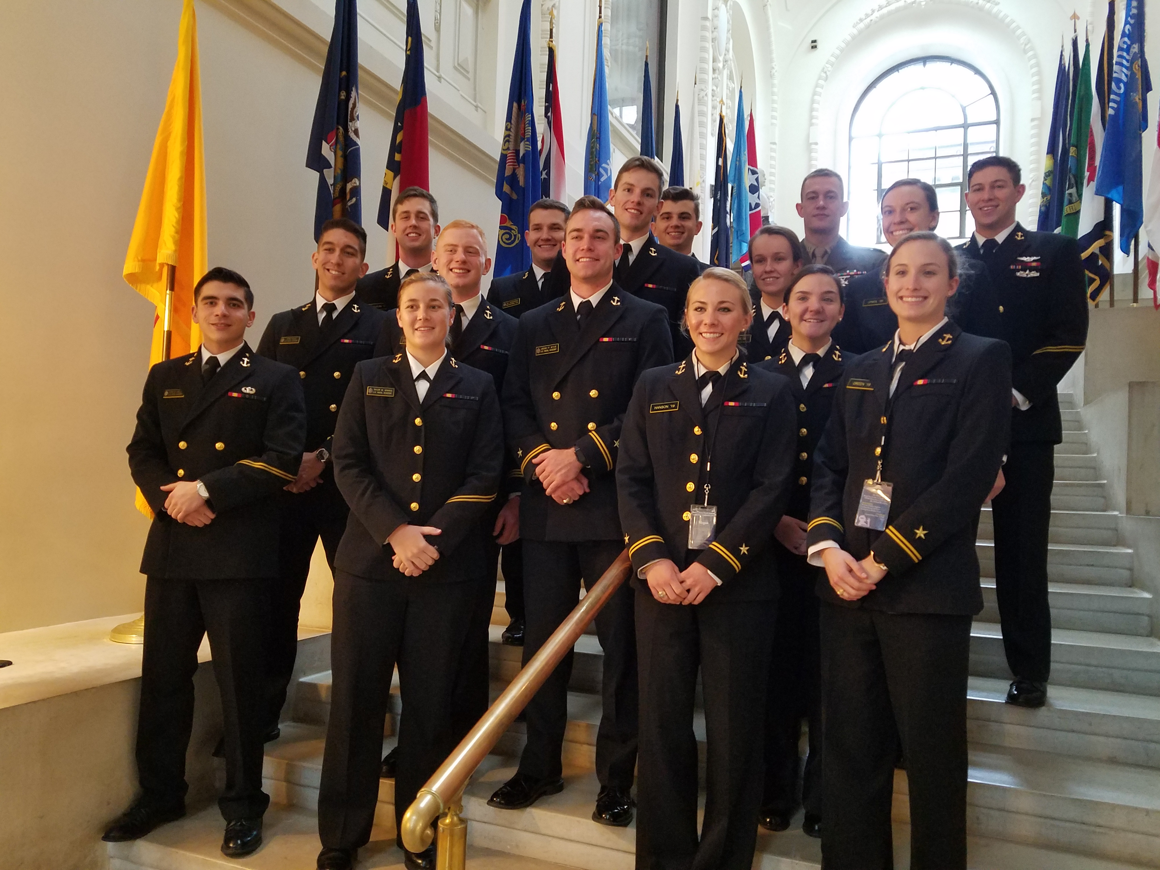
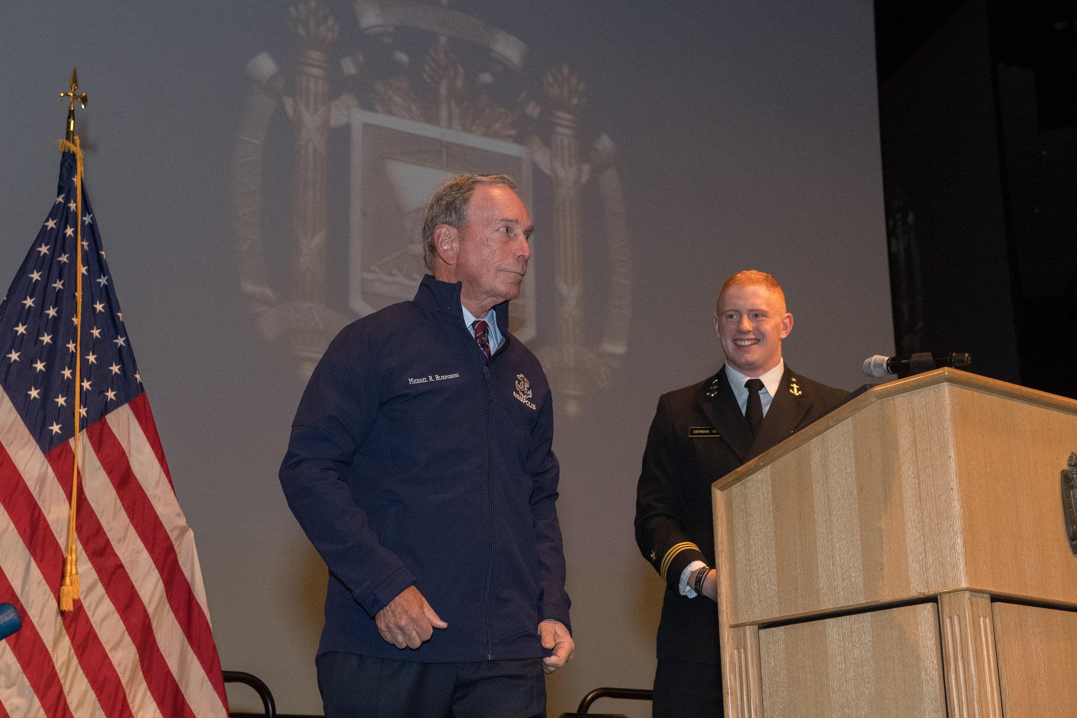
Center for ELD
Naval Academy Leadership Conference (NALC).
  Well-established program that now falls under ELD.
  Staffed entirely with 1/C and 2/C midshipmen and over 150 additional volunteers during the conference.
  Full year of planning.
  Over 400 delegates from other colleges and universities (civilian institutions as well as service academies).

Slide 18
NOLS Feedback
“Unlike any leadership training I received at the Academy or during Navy summer training opportunities, NOLS teaches skills in an environment that puts them to the test in a very real way.”
“There is no doubt in my mind that conquering the complexities of Alaska's Matanuska Glacier helped me conquer the complexities of combat in Iraq.”
“Of all the training I received while at USNA, my NOLS experience is the only event that I drew strength from while conducting combat operations along the Afghan-Pakistan border as a Combat Advisor to the Afghan National Security Forces.”
“I learned more about practical leadership in just a few days than I ever could have in other summer training programs.”
“By far the best leadership experience I received while attending the U.S. Naval Academy.”

Slide 19
USNA Leadership Hub
Cloud-based interface that integrates into one site the following:
  Leadership curriculum metrics/assessments.
  Access to leadership classroom content.
  Leadership research.
  Developmental survey results.
  Feedback from summer training programs and athletic teams.
Faculty, staff, and coaches will be able to create events that midshipmen may join.
  Includes leadership development goals.
Graduates may access the hub after commissioning.

Slide 20
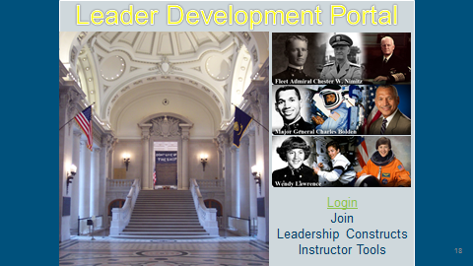

Slide 21
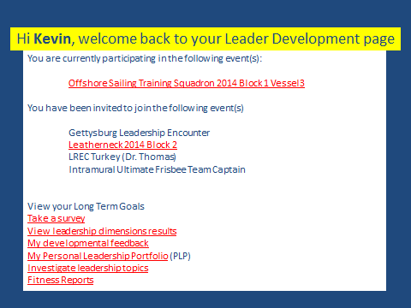

Slide 22
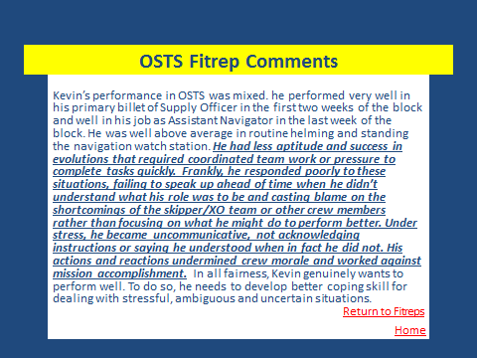

Slide 23
ELD Vision 2025 and Beyond
With continued success and increased donor interest, ELD can grow well beyond its current scope and size:
  Donor and Foundation interest - ELD Dinners.
  Gettysburg - increasing publicity, ‘77 donations, and overall buzz & interest.
Battlefield trips OCONUS.
  2019 Vietnam trip with IPO.
    Added benefit of cultural immersion (IPO mission / Adaptable midshipmen attribute).
  Potential for future trips (2 per year).
Future permanent ELD positions:
  Deputy Director.
  Full-time AD position.

Slide 24
Questions?

